Slide 1
Introduction To PLC Programming

Slide 2
Intro to PLC Programming
For most PLC, the programming languages is based on the IEC 61131-3
Ladder diagram (LD), graphical
Function block diagram (FBD), graphical
Structured text (ST), textual
Instruction list (IL), textual
Sequential function chart (SFC), graphical
Two types of PLC
Address Based
Variable Based

Slide 3
Intro to PLC Programming
Basic Data Types
Boolean (1 bit)
WORD (16 bits), DWORD (32 bits)
does not represent a number only an array of bits
Most PLC allows you to access these bits using the Dot Operator or [].
INT (16 bits) – represent a signed number 0 – 65535
UINT (16 bits) – represent a unsigned number - 0 to 65535
DINT (32 bits) – represent a signed number (-2147483648) – (2147483648)
UDINT (32 bits) - represent a unsigned number
REAL (32 bits) – single precision floating point number (IEEE-754 )
LREAL (64 bits) –double precision floating point number (IEEE-754 )
Time (64 bits) – define a time variable (HH:MM:SS:MS:US:NS)
String ( 8 bits * Char) – defines an array of chars

Slide 4
Intro to PLC Programming
Array
collection of data elements of the same data type
Structure
Allows of a set of variables to be grouped together
Unions
data structure that usually contains different data types
All components have the same offset
occupy the same memory space
Enumeration
An ordered list of all items in a collection

Slide 5
Intro to PLC Programming
Basic Ladder Elements
Open Contact
Close Contact
Coil
Set
Reset

Slide 6
Intro to PLC Programming
Write a basic Ladder diagram

Slide 7
Intro to PLC Programming
Problems with writing PLC Code for Large program
Cumbersome
Difficult to debug
Slow
Hard to follow

Slide 8
Intro to PLC Programming
Solving the problem with writing big program
Structured programming is a programming paradigm aimed at improving the clarity, quality, and development time of a computer program by making extensive use of the structured control flow constructs of selection (if/then/else) and repetition (while and for), block structures, and subroutines in contrast to using simple tests and jumps such as the go to statement, which can lead to “spaghetti code” that is potentially difficult to follow and maintain.
https://press.rebus.community/programmingfundamentals/chapter/structured-programming/

Slide 9
Intro to PLC Programming
Solving the problem with writing big program
The mechanisms that allow us to control the flow of execution are called control structures.
Sequence – Very boring. Simply do one instruction then the next and the next. Just do them in a given sequence or in the order listed. Most lines of code are this.
Selection – This is where you select or choose between two or more flows. The choice is decided by asking some sort of question. The answer determines the path (or which lines of code) will be executed.
Iteration – Also known as repetition, it allows some code (one to many lines) to be executed (or repeated) several times. The code might not be executed at all (repeat it zero times), executed a fixed number of times or executed indefinitely until some condition has been met. Also known as looping because the flowcharting shows the flow looping back to repeat the task
https://press.rebus.community/programmingfundamentals/chapter/structured-programming/

Slide 10
Intro to PLC Programming
Define a Block of code
That can run a sequence in a controlled way
Numerically Sequenced
can be skipped to improve cycle time
Use jump and label in a limit fashion
Stage and End Stage command
Have enable flag (bit)
Enter or start the sequence
Exit or stop the sequence

Slide 11
Intro to PLC Programming
Defining a Block of code for Omron CX-Programmer

Slide 12
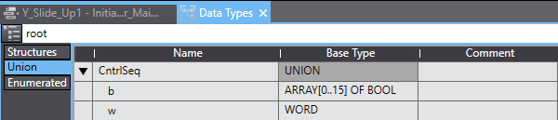
Intro to PLC Programming
Defining a Block of code for Omron SYSMAC

Slide 13
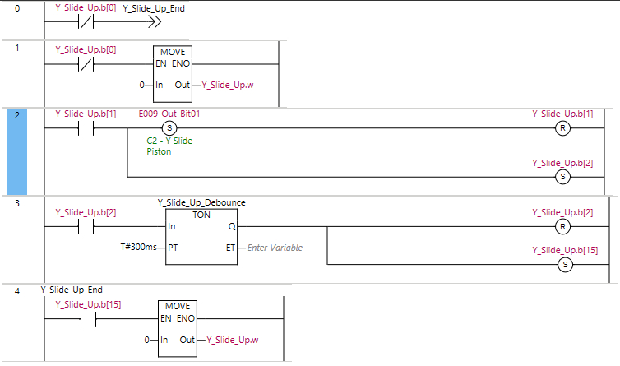
Intro to PLC Programming
Defining a Block of code for Omron SYSMAC

Slide 14
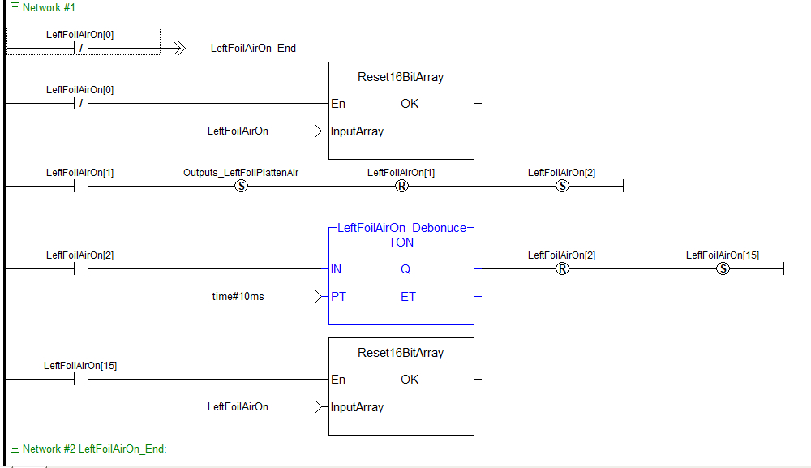
Intro to PLC Programming
Defining a Block of code for Kollmorgen Automation Suite
LeftFoilOn[x] is an array of 16 bool
LeftFoilOn[0] is the Enabling bit
If LeftFoilOn[0] is Off the
-->> LeftFoilAitOn_End is the Jump Statement that bypasses this Network of code.
On Network #2: LeftFoilAirOn_End is the label that the Jump statement refers to.
The Reset16BitArray function block is used to reset the individual bits in the array
LeftFoilOn[1] is the starting bit for the block of code
LeftFoilOn[1] rung sets an output variable “Outputs_LeftFoilPlattenAir” then proceed to reset the current rung LeftFoilOn[1] then set the next rung LeftFoilOn[2].

Slide 15
Intro to PLC Programming
Defining a Block of code for Kollmorgen Automation Suite : Continued
LeftFoilAirOn[2] Rung enables a Timer On function block defined by literal time variable time#10ms.
After 10ms the LeftFoilAirOn[2] rung is Reset and the Last Bit in the array is set to finish the block.
LeftFoilAirOn[15] activates the Reset16BitArray function block which reset the array of bits in the LeftFoilAirOn array thereby turning off the block of code.
This block code represents the basic building block of ladder logic that will be used to write your programs.

